Slide 1
What's the smart question?
Journey to your best
Phạm Nguyễn Thuận

Slide 2
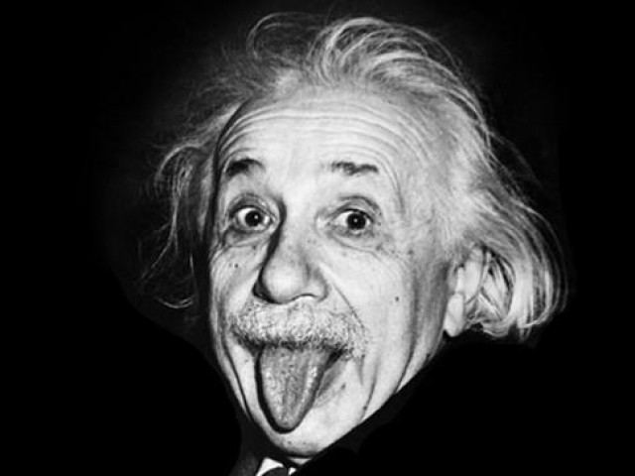
"Questions are the key that opens the door of knowledge.“
Albert Einstein

Slide 3

Table of contents
Why ask question?
How to ask questions?
What's the smart question?
example

Slide 4
I. Why ask questions?
To collect information
To solve problems
To think critically
To communicate and build relationships

Slide 5

II. How to ask questions?
Before you ask:
Identify your purpose
Consider your audience
Do your research

Slide 6

II. How to ask questions?
When you ask:
Be clear and concise
Use open-ended questions
Use active voice
Be respectful

Slide 7

II. How to ask questions?
After you ask:
Listen actively
Ask follow-up questions
Be grateful

Slide 8

III. What's the smart question?
Highly effective questions are SMART questions
Questions are suggestive and thought-provoking, helping respondents better understand the problem and give complete and comprehensive answers.

Slide 9
There are 5 criteria for evaluating smart question:
Specific
Measurable
Action Oriented
Relevant
Time-bound

Slide 10

a. Specific
Is the question specific? Does it address the problem? Does it have context? Will it uncover a lot of the information you need?

Slide 11

B. Measurable
Will the question give you answers that you can measure?

Slide 12

C. Action oriented
Will the answers provide information that helps you devise some type of action plan?

Slide 13

d. Relevant
Is the question about the particular problem you are trying to solve?

Slide 14

E. Time Bound
Will the answers allow you solve the problem sooner rather than later?

Slide 15
IV. example
Problem context:
Product A is a new product that was launched by the company in the previous quarter.
Product A's sales in the previous quarter did not meet the target.
The company needs to find ways to increase Product A's sales in the next quarter.

Slide 16
How to increase product a's sales in the next quarter, while maintaining product and service quality?

Slide 17
Specific: The question only focuses on Product A and a specific time period.
Measurable: Product A's sales can be measured by tracking the number of products sold in the quarter.
Action-oriented: The question requires specific solutions to increase sales.
Relevant: The question is relevant to the company's goal of increasing Product A's sales.
Time-bound: The question has a deadline of the next quarter.

Slide 18
THANK YOU
Anthony Phạm
NguyenThuanPham@outlook.com
www.thuanpham.work (coming soom)

